Slide 1
Ozone Calibration Data

Slide 2
Changes in Data
The monitor is now reading lower concentrations during the initial peak of a run.
However, rate of increase of ozone concentration seems to be increasing. (It takes longer to stabilize.)
AirU sensors are showing less resolution in peaks than previously. This does not necessarily seem to be linked to low concentrations of ozone.
In some cases, the NOX value is increasing rather than decreasing.

Slide 3
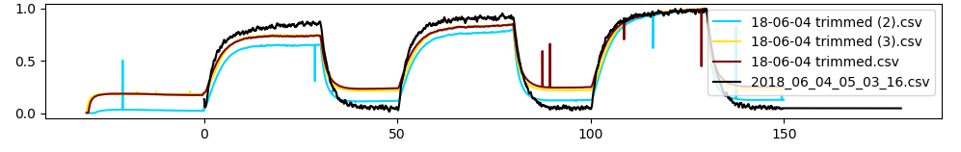
O3_2018-06-04-14-32_C (A run with casing that gave us ‘normal’ data.)
87 | Peak 1 | Peak 2 | Peak 3 | R²
Monitor Concentration | 88.9 ppb | 96.7 ppb | 101.3 ppb
S5 NOX Value | 521 | 470 | 414 | 99.6%
S8 NOX Value | 1113 | 980 | 879 | 98.9%
S12 NOX Value | 1064 | 995 | 912 | 99.0%
Sensor 12 NOX values

Slide 4
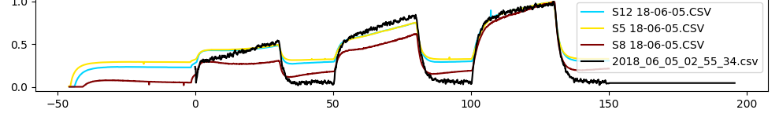
O3_2018-05-23-12-57_nofan (A run without the fan that gave us ‘normal’ data).
87 | Peak 1 | Peak 2 | Peak 3 | R²
Monitor Concentration | 127.2 ppb | 148.5 ppb | 157.7 ppb
S5 NOX Value |  |  |  | 91.1%
S8 NOX Value |  |  |  | 96.0%
S12 NOX Value | 721 | 530 | 392 | 95.5%
Sensor 12 NOX values

Slide 5
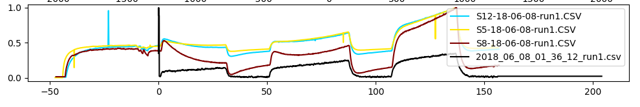
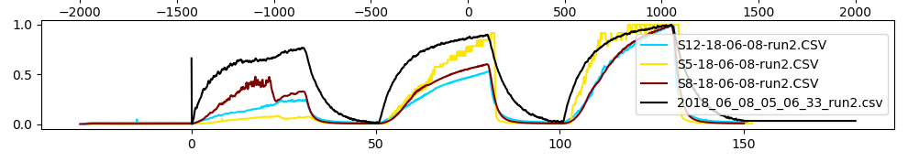
O3_2018-06-08-11-00_C1000ppb
Sensor 12 NOX values
 | Peak 1 | Peak 2 | Peak 3 | R²
Monitor Concentration | 37 ppb | 60 ppb | 86 ppb
S5 NOX Value | 1070 | 950 | 740 | 84.0%
S8 NOX Value | 1640 | 1712 | 1434 | 77.8%
S12 NOX Value | 1525 | 1455 | 1253 | 81.7 %
O3_2018-06-08-14-36_nofan1000ppb
Sensor 12 NOX values
 | Peak 1 | Peak 2 | Peak 3 | R²
Monitor Concentration | 210 ppb | 246 ppb | 275 ppb
S5 NOX Value | 139 | 12 | 11 | 89.6%
S8 NOX Value | 159 | 129 | 79 | 96.7%
S12 NOX Value | 394 | 203 | 112 | 98.1%

Slide 6
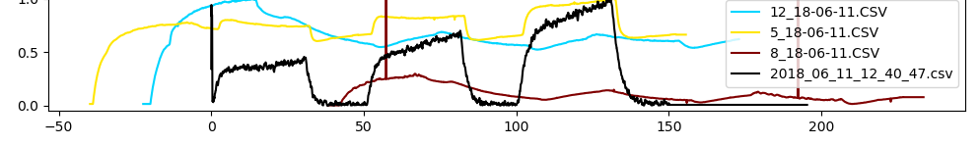
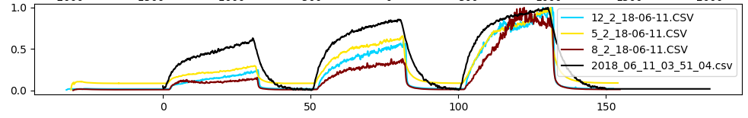
O3_2018-06-11-10-10_Cnofan
Sensor 12 NOX values
 | Peak 1 | Peak 2 | Peak 3 | R²
Monitor Concentration | 34.4 ppb | 53 ppb | 76 ppb
S5 NOX Value | 1025 | 1000 | 920 | 95.3%
S8 NOX Value | 1655 | 1823 | 1843 | 8.9%
S12 NOX Value | 1431 | 1581 | 1588 | 3.1%
O3_2018-06-11-13-20_nofan
Sensor 12 NOX values
 | Peak 1 | Peak 2 | Peak 3 | R²
Monitor Concentration | 106 ppb | 145 ppb | 171 ppb
S5 NOX Value | 528 | 275 | 201 | 98.5%
S8 NOX Value | 531 | 250 | 119 | 96.3%
S12 NOX Value | 332 | 155 | 95 | 95.3%

Slide 7
Sensor 12 NOX values
O3_2018-06-04-14-32_C
O3_2018-06-08-11-00_C1000ppb
O3_2018-06-08-14-36_nofan1000ppb
O3_2018-06-11-10-10_Cnofan

Slide 8
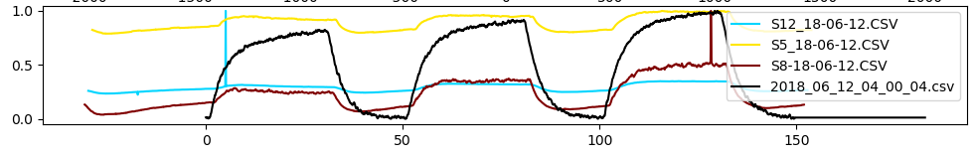
O3_2018-06-12-13-30_C
AirU sensors were placed in chamber and warmed up. Chamber was flooded with ozone for 50 min prior to running test.
87 | Peak 1 | Peak 2 | Peak 3 | R²
Monitor Concentration | 128.7 ppb | 143.8 ppb | 157.4 ppb
S5 NOX Value |  |  |  | ?
S8 NOX Value |  |  |  | ?
S12 NOX Value | 1631 | 1616 | 1590 | ?

